Slide 1

Data Science Metrics

Slide 2
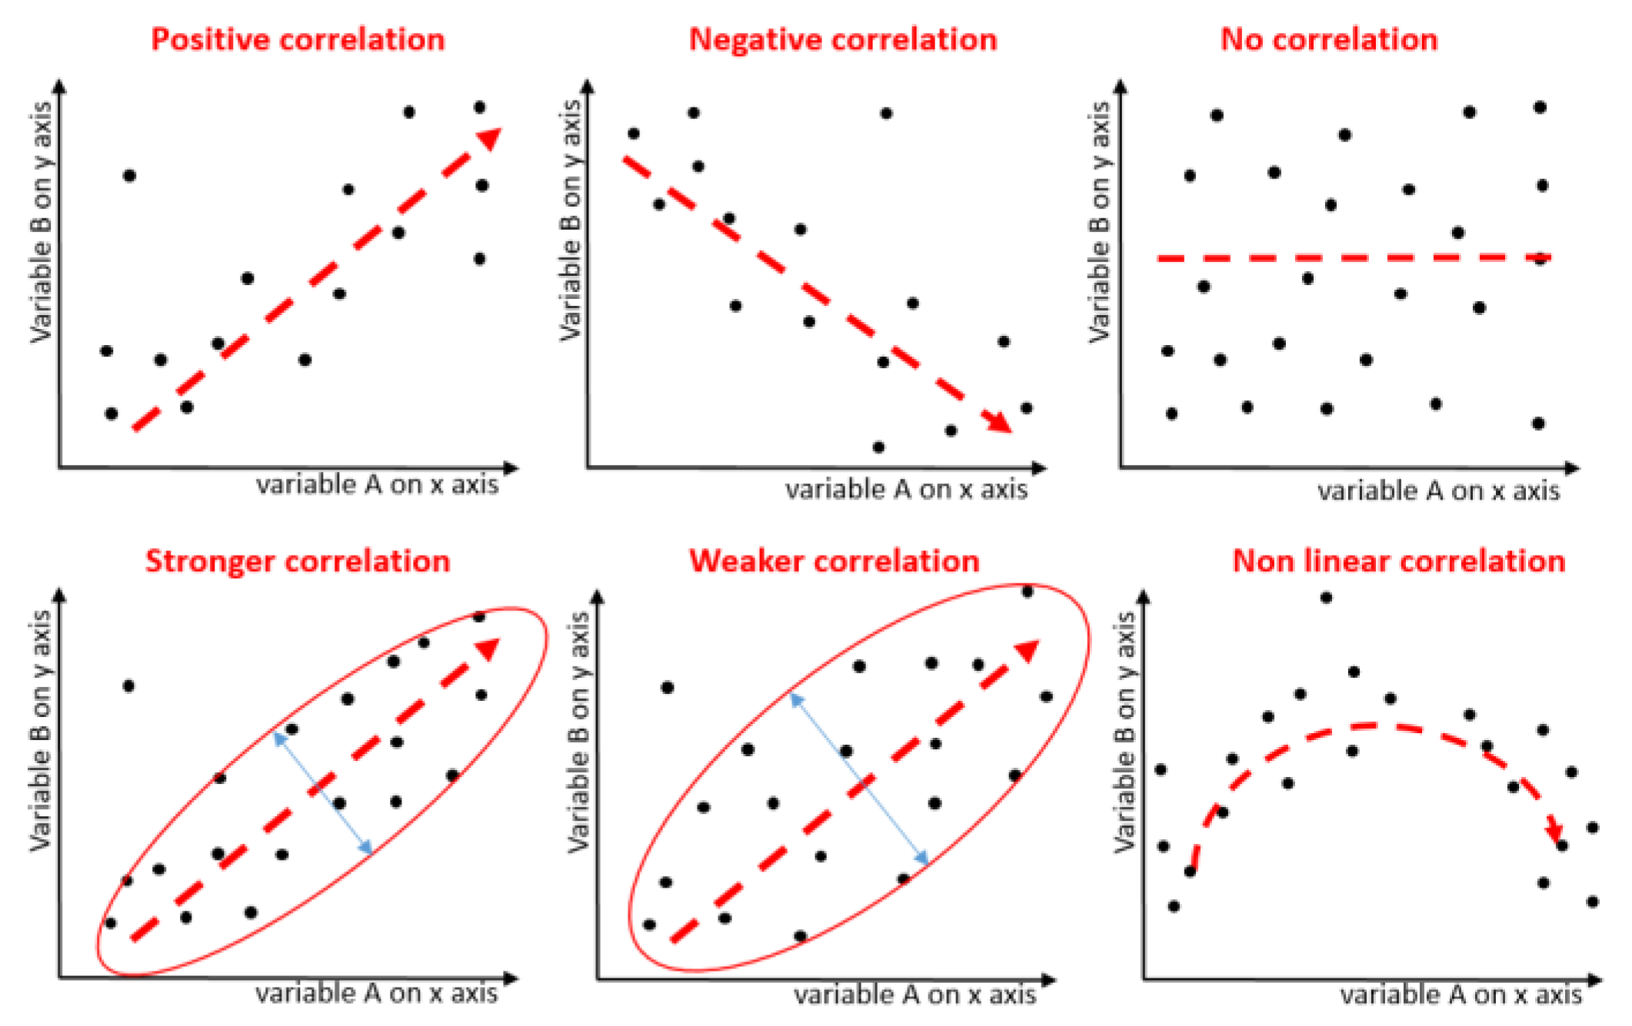
Correlation

